Slide 1
Final Engagement
Attack, Defense & Analysis of a Vulnerable Network
Presented by: Sir Hacksalot and the Knights of the SQL Table
Emily Theodorakos
John Curzon
Thomas Leonard
Stephanie Valentin

Slide 2
Table of Contents
This document contains the following resources:
Network Topology & Critical Vulnerabilities
Exploits Used
Methods Used to Avoiding Detect

Slide 3

Network Topology
& Critical Vulnerabilities
‹#›

Slide 4
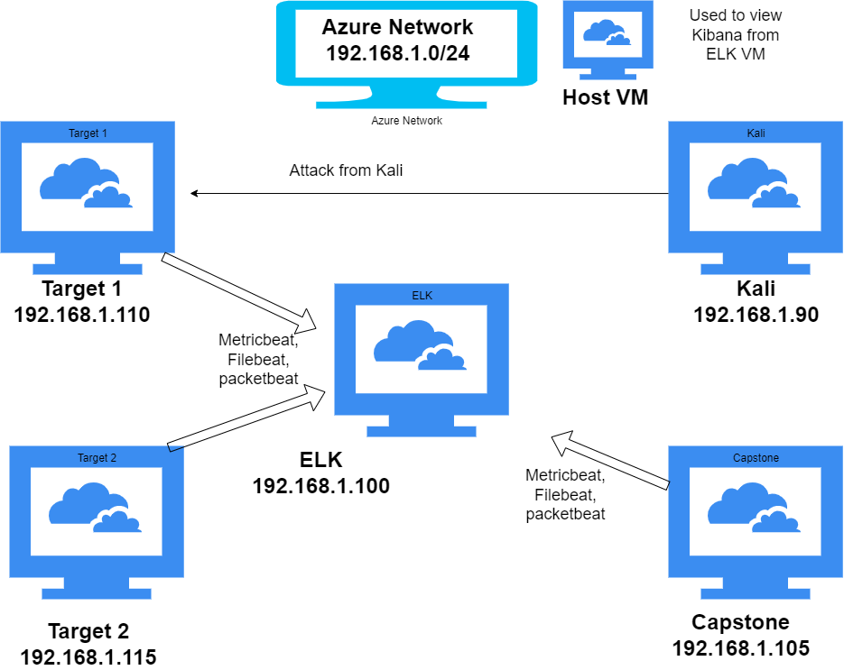
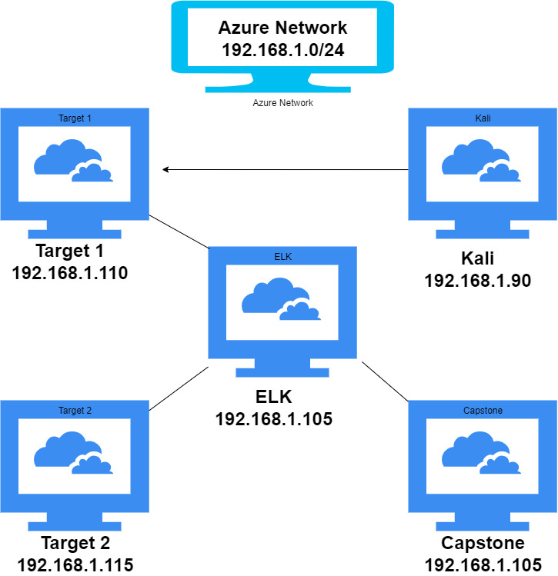
Network Topology
Network
Address Range: 192.168.1.0/24
Netmask:255.255.255.0
Gateway:192.168.1.1
Machines
IPv4:192.168.1.90
OS:Linux
Hostname:Kali
IPv4: 192.168.1.100
OS: Linux
Hostname: ELK
IPv4: 192.168.1.110
OS: Linux
Hostname: Target 1
IPv4: 192.168.1.115
OS: Linux
Hostname: Target 2
IPv4: 192.168.1.105
OS: Linux
Hostname: Capstone
[Insert Here]
Use draw.io to create a diagram of the network.
Add your diagram to this slide and fill out the data in the sidebar.

Slide 5
Critical Vulnerabilities: Target 1
Our assessment uncovered the following critical vulnerabilities in Target 1.
Vulnerability | Description | Impact
Weak Password | michael: michael steven:pink84 | One was simply to guess One was easy to crack the hash
Wordpress | Passwords for SQL in plain text WPScan Provided Recon Information | Just needed access to machine to gain additional access Easily Able to obtain Usernames
Sudo python | Had sudo privileges for python | Able to use python script to elevate to root access

Slide 6
Critical Vulnerabilities: Target 2
Our assessment uncovered the following critical vulnerabilities in Target 2.
Vulnerability | Description | Impact
Hidden Files | Normally only seen by those with credentials, these directories and files weren’t locked from public viewing | Potential confidential information located here
 | Takes forever | dirb http://192.168.1.115/
 | Quick but had to install first | gobuster -w /usr/share/wordlist dir -u http://192.168.1.115/
PHP Mailer Autoloader | CVE-2016-10033

Slide 7
Exploits Used
‹#›

Slide 8
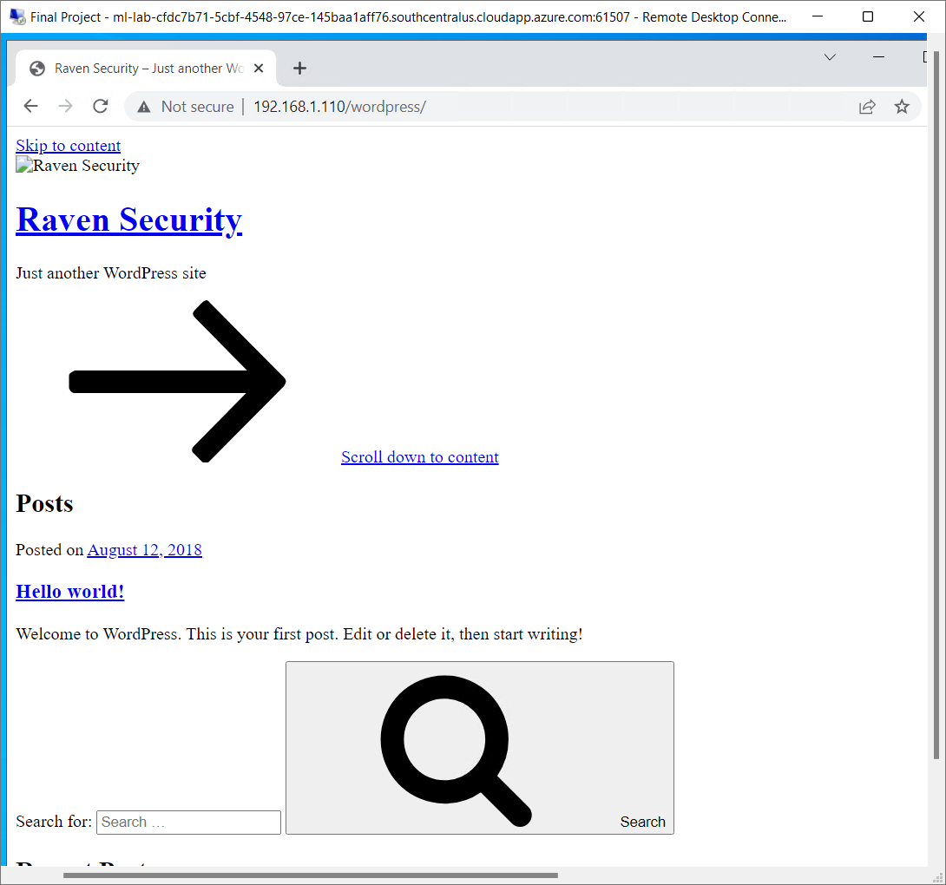
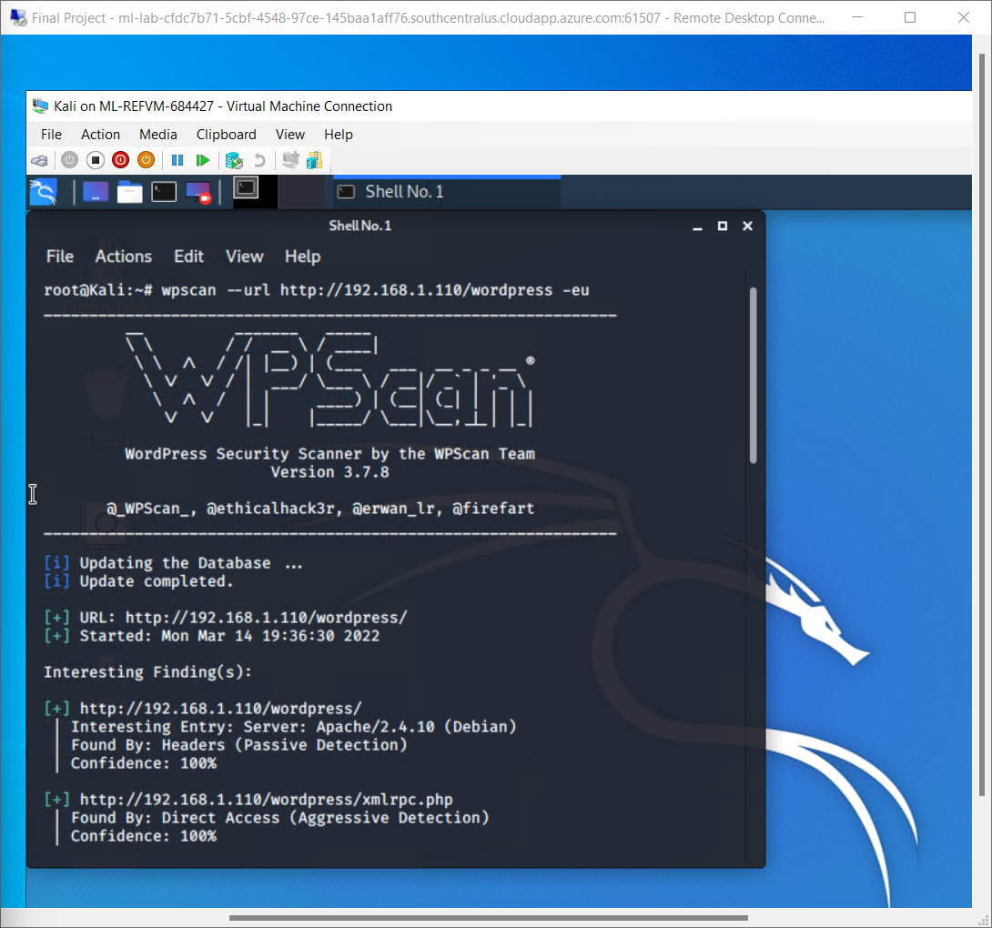
Exploitation: WordPress
Summarize the following:
Typed “192.168.1.110/wordpress/” into browser, to confirm the server WordPress site was up and running.
Used the command wpscan –url http://192.168.1.110/wordpress -eu to scan for potential users names.

Slide 9
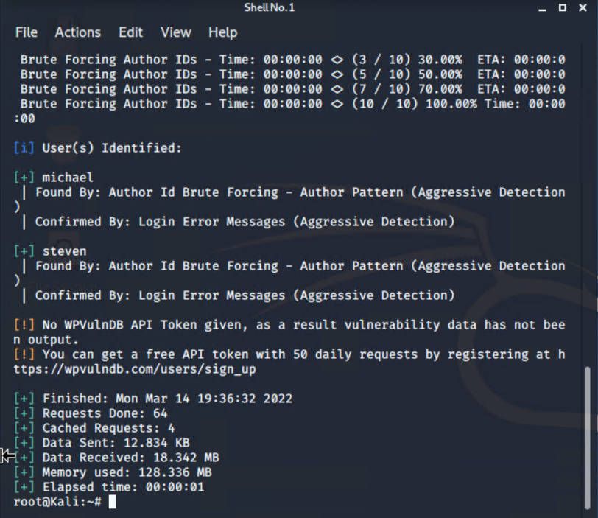
Exploitation: WordPress
Achievements
Was able to determine that michael and steven are users

Slide 10
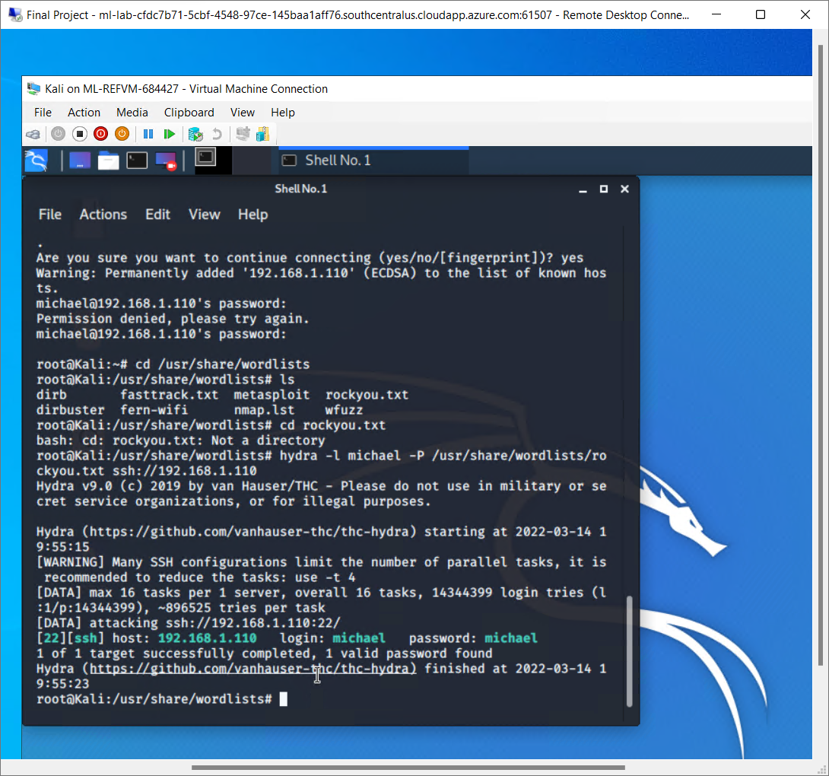
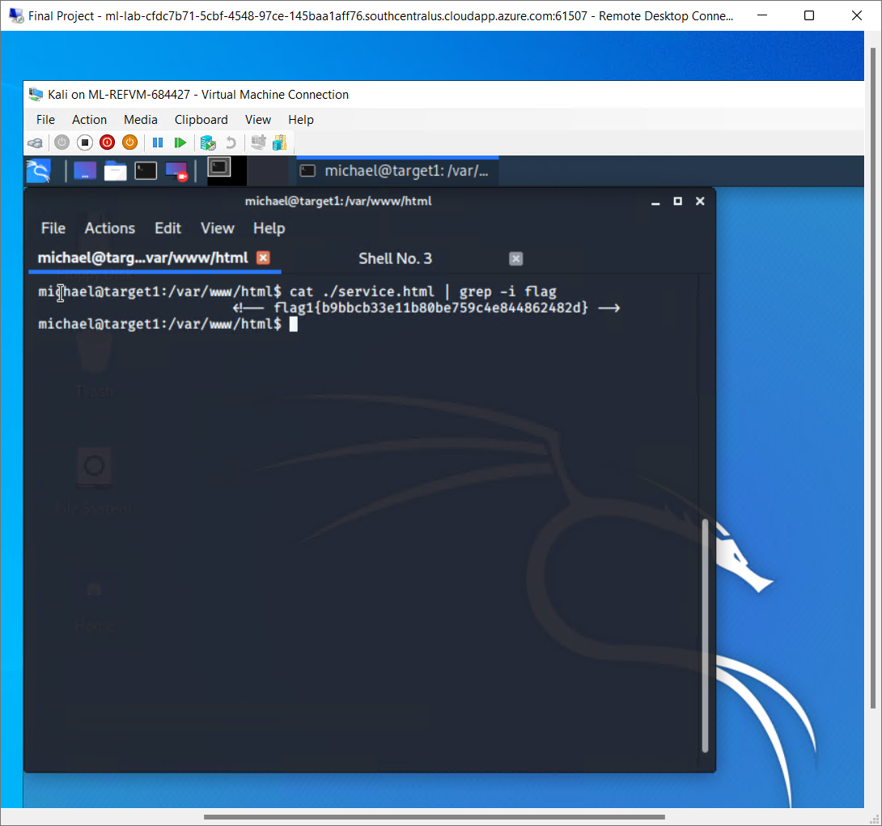
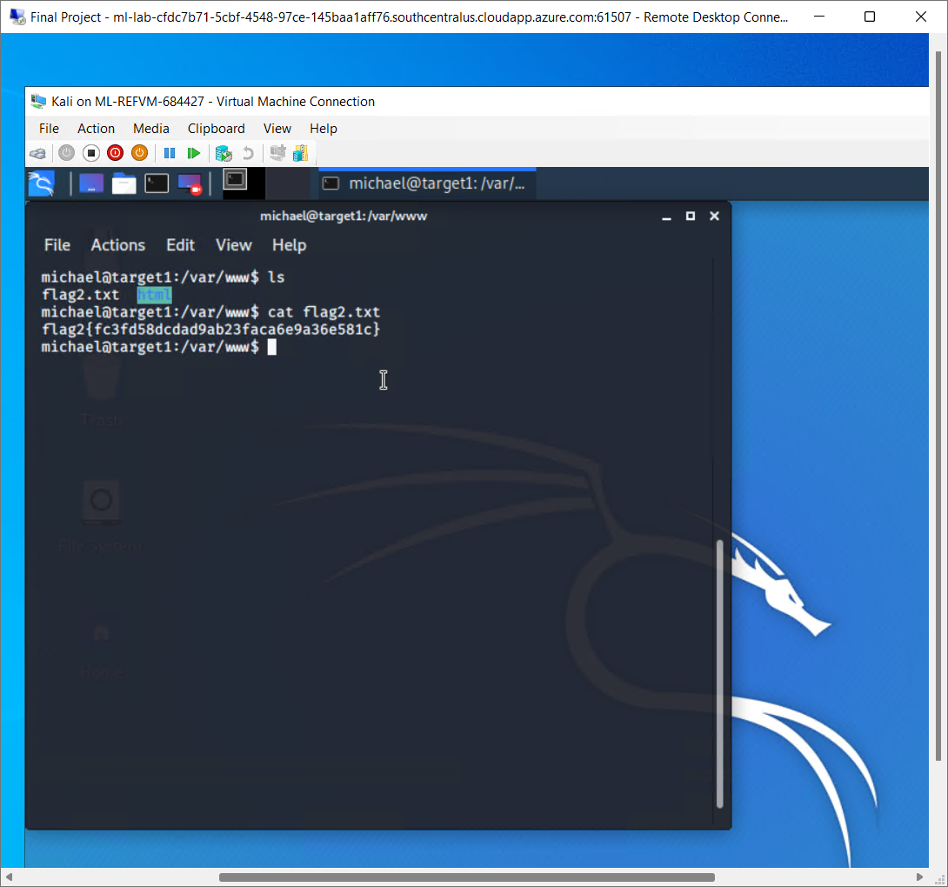
Exploitation: Weak Password
Summarize the following:
michael:michael, password same as username, easy to guess
Another option was to use the command hydra -l michael -P /usr/share/wordlists/rockyou.txt ssh://192.168.1.110
Was able to locate flags 1 and 2 with Michael’s credentials

Slide 11
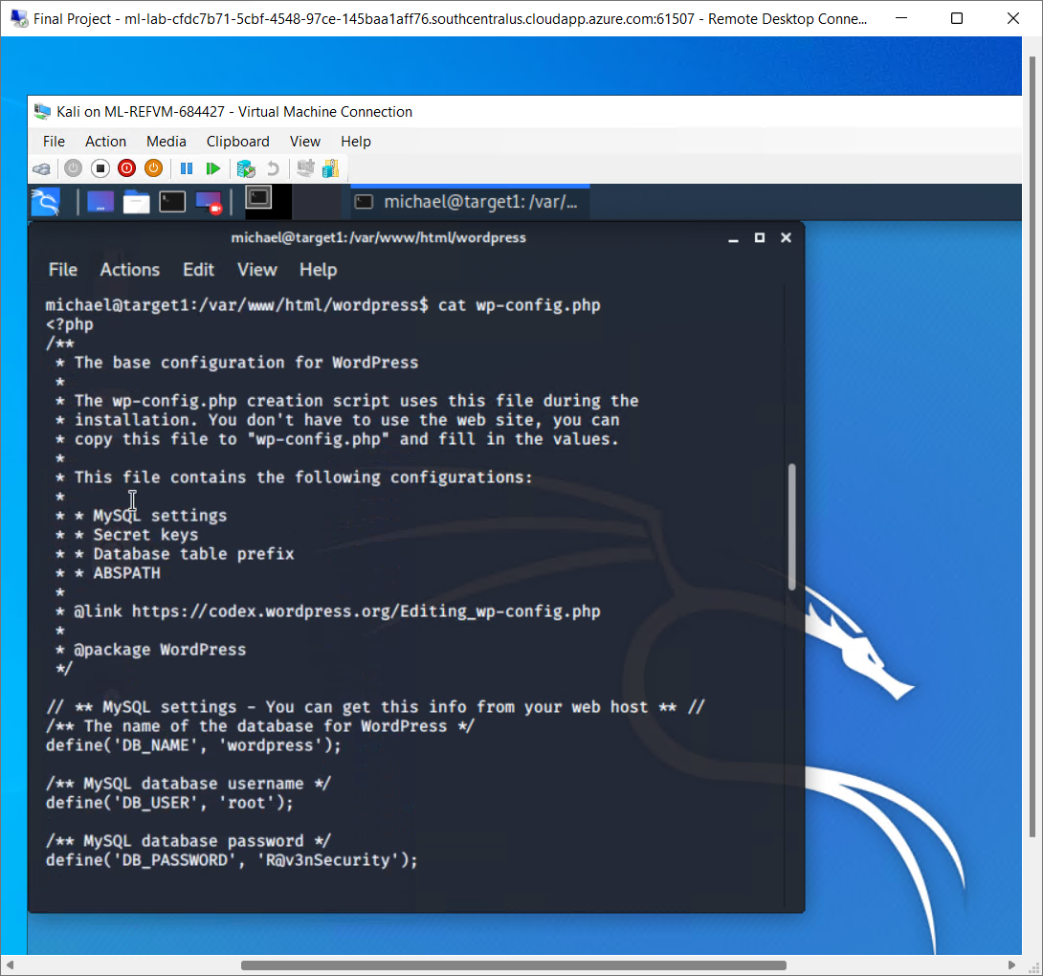
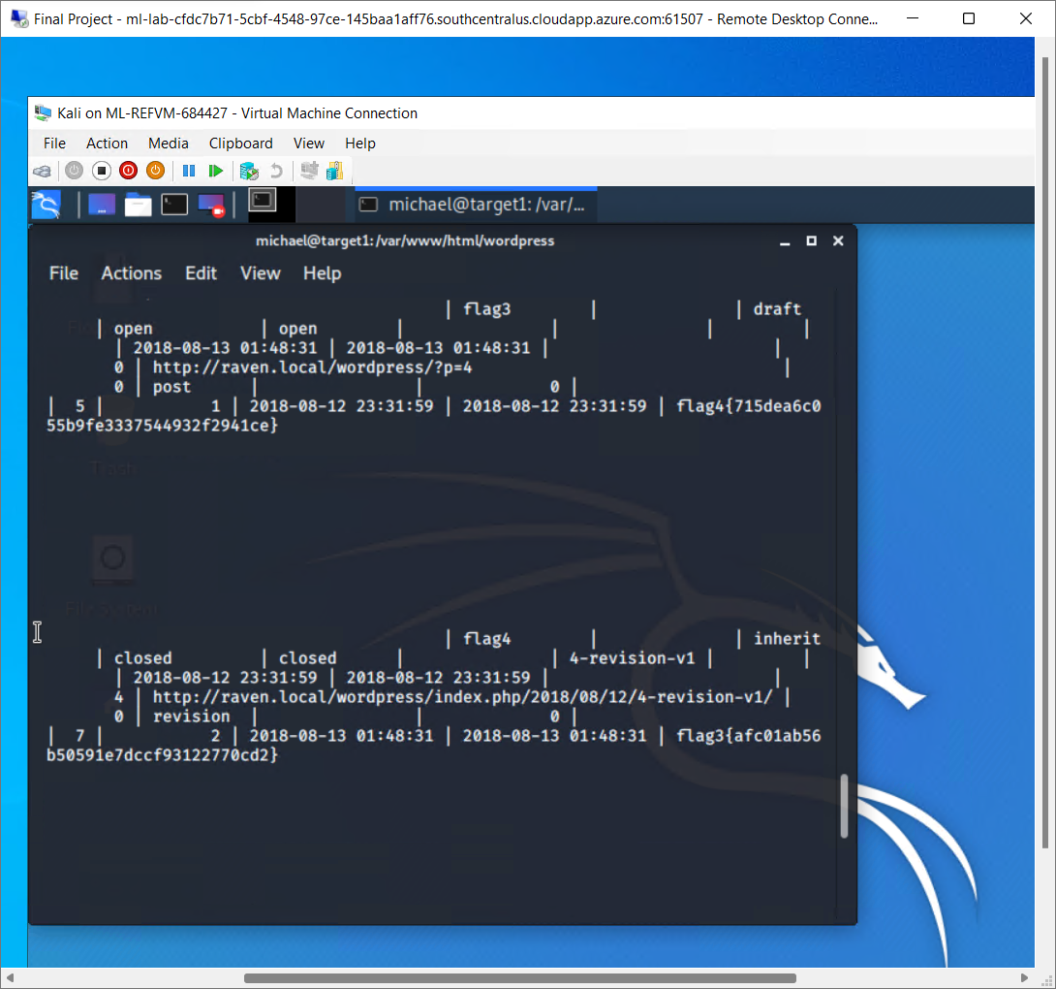
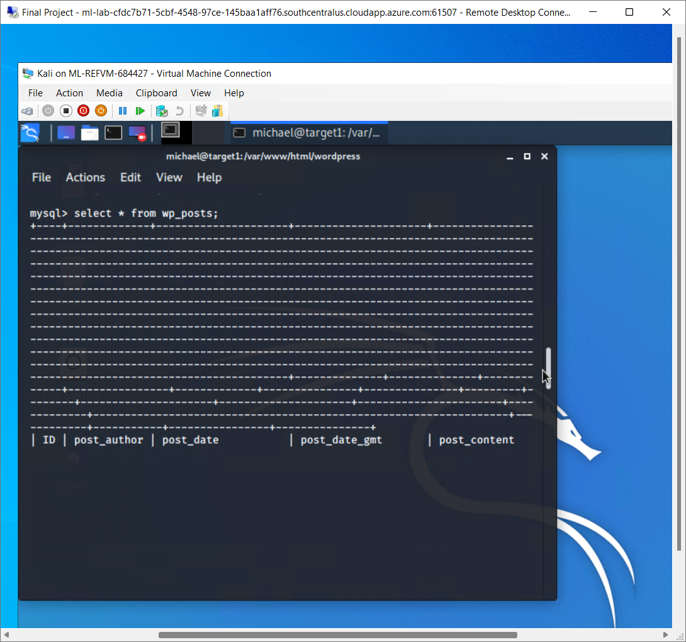
Weak Passwords
MySQL passwords were in plain text in the wp-config file (root:R@v3nSecurity)
Achievement: Was able to locate flags 3 and 4 with the saved plain text MySQL credentials
a

Slide 12
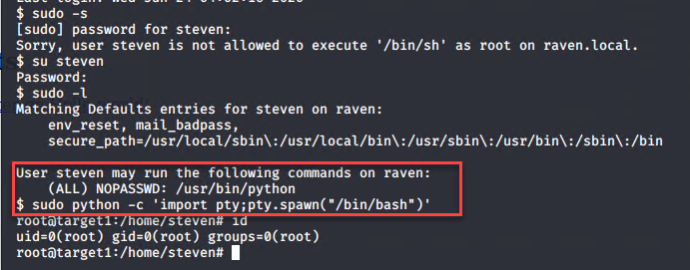
Exploitation: Sudo Python
Exploited the password hash of user ‘steven’ using John the Ripper and accessed the account
Username: steven
Password: pink84
User had python sudo privileges which were exploited through spawn shell.
Command used: sudo python -c ‘import pty;pty.spawn(“/bin/bash”)’

Slide 13
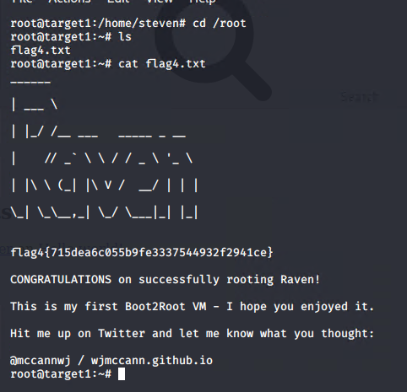
Sudo Python
Achievements
Was able to find flag 4 after gaining root access to steven’s account
Commands used:
cd /root
ls
cat flag4.txt

Slide 14
Avoiding Detection
‹#›

Slide 15
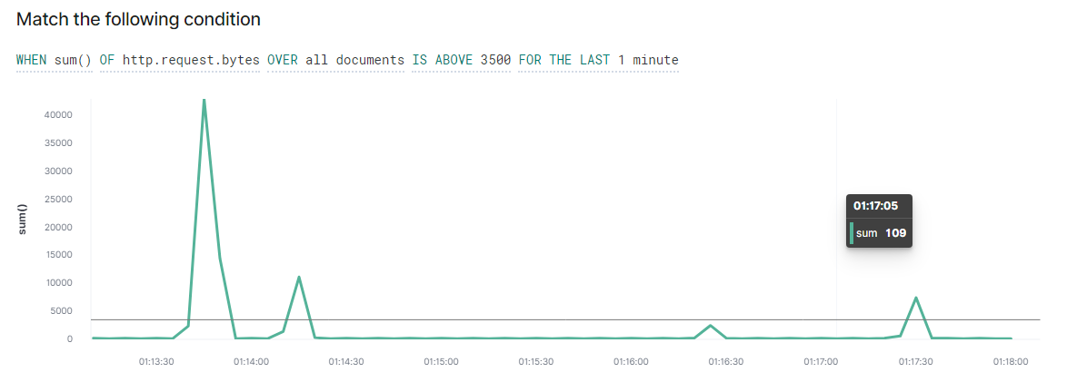
Stealth Exploitation of Wordpress (Enumeration)
Monitoring Overview
Which alerts detect this exploit?
Kibana Alert: HTTP Request Size Monitor (WHEN sum() of http.request.bytes OVER all documents IS ABOVE 3500 FOR THE LAST 1 minute)
Which metrics do they measure?
HTTP Request Size Monitor: Bytes of HTTP Requests
Which thresholds do they fire at?
HTTP Request Size Monitor: Above 3500 Bytes in 1 minute

Slide 16
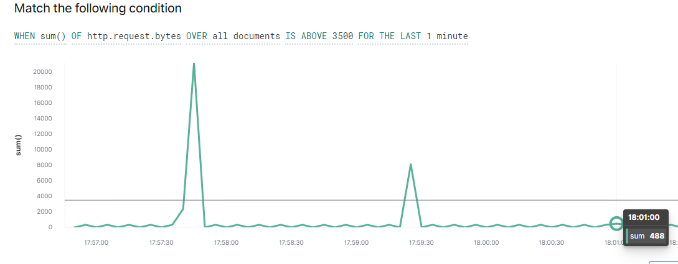
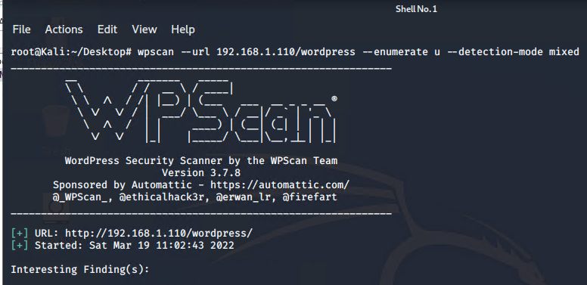
Stealth Exploitation of Wordpress (Enumeration) Part 2
Mitigating Detection
How can you execute the same exploit without triggering the alert?
Passive and mixed options are available on the WPScan, which have smaller request sizes and can potentially avoid triggering the Alerts, but they also will produce less information
Are there alternative exploits that may perform better?
Using the passive or mixed options for a scan will lower the HTTP request Size, however other methods may need to be utilized because passive WPScans will produce less reconnaissance information.
Command: wpscan --url http://192.168.1.110/wordpress -- enumerate u --detection-mode (passive, mixed, aggressive)

Slide 17
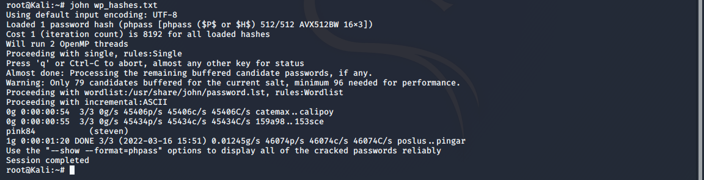
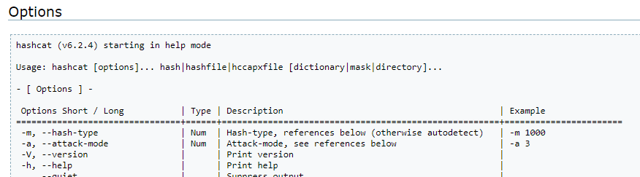
Stealth Exploitation of Weak Passwords
Monitoring Overview
Which alerts detect this exploit?
Kibana Alert: CPU Usage Monitor (WHEN max() OF system.process.cpu.total.pct OVER all documents IS ABOVE 0.5 FOR THE LAST 5 minutes)
Which metrics do they measure?
System Processes Using CPU resources
Which thresholds do they fire at?
Above .5 for the last 5 minutes
Mitigating Detection
How can you execute the same exploit without triggering the alert?
John the ripper uses significant CPU resources to crack passwords which could cause the alert to trigger if it is run on the target machine, copying hashes to your personal attacking machine and running John will prevent this, as it is using your own resources
Are there alternative exploits that may perform better?
There are alternate tools that can be used to crack hashes, for example, hashcat makes use of a system’s GPU instead of CPU

Slide 18
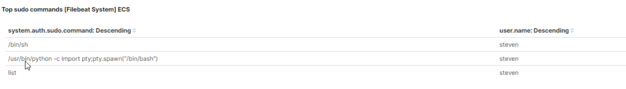
Stealth Exploitation of Sudo Python
Monitoring Overview
According to the Kibana data, the alerts set were not triggered by the sudo python command. However, using a security monitoring software such as Insider Threat Management (ITM) provides alerts that are triggered by a user using a sudo command to open a root shell without a required password. If we were to have had an ITP alert to monitor sudo commands in a shell, it would have been triggered.
Kibana monitors the system.auth.sudo.command which logs the users and the sudo commands that the user has executed where we see user steven has executed /usr/bin/python -c import pty;pty.spawn(“/bin/bash”) to gain root access

Slide 19
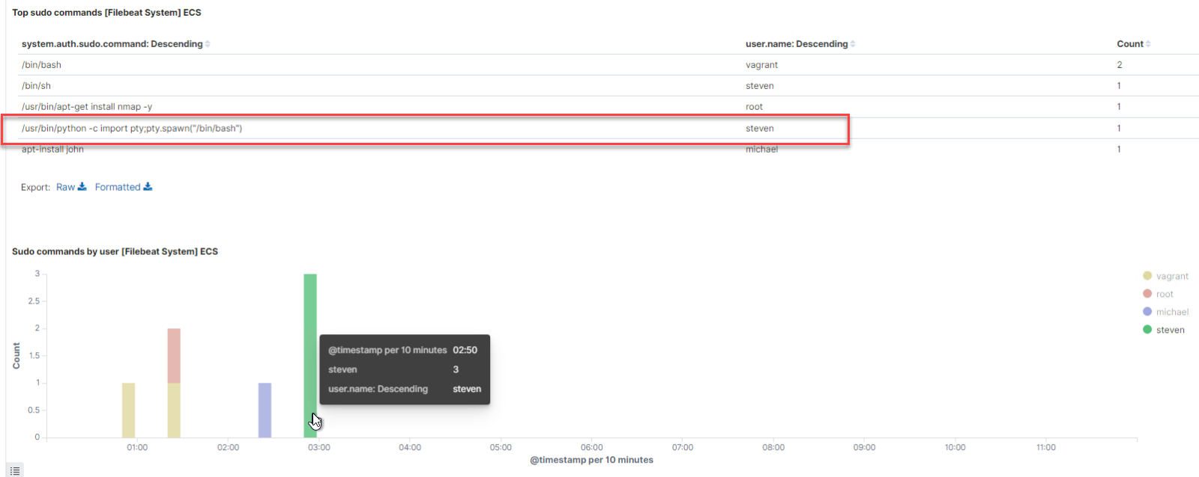
Stealth Exploitation of Sudo Python

Slide 20
Stealth Exploitation of Sudo Python
Mitigating Detection
Being that the alerts we created through Kibana were NOT triggered we wouldn’t have to change the execution of our exploit.
If we were to implement the ITM alert discussed earlier it would be difficult to go undetected. We are unsure if it would be possible to execute the same python exploitation without using sudo.

Slide 21
Sources:
param373r. (2020, June 10). John the ripper. Medium. Retrieved March 19, 2022, from https://param373r.medium.com/john-the-ripper-acf598f30ffa
Hashcat advanced password recovery. hashcat [hashcat wiki]. (n.d.). Retrieved March 19, 2022, from https://hashcat.net/wiki/doku.php?id=hashcat
Brown, K. (2020, December 30). Use WPSCAN to scan WordPress for vulnerabilities on Kali. Linux Tutorials - Learn Linux Configuration. Retrieved March 19, 2022, from https://linuxconfig.org/use-wpscan-to-scan-wordpress-for-vulnerabilities-on-kali
25, M., & Friedlander, G. (2021, July 26). 7 ways proofpoint ITM can detect privileged escalations in unix: Proofpoint us. Proofpoint. Retrieved March 19, 2022, from https://www.proofpoint.com/us/blog/insider-threat-management/7-ways-proofpoint-itm-can-detect-privileged-escalations-unix

